Slide 1


Slide 2
# What is Vue?

Slide 3

JavaScript

Slide 4


Slide 5

Brendan Eich

Slide 7

Evan You

Slide 8
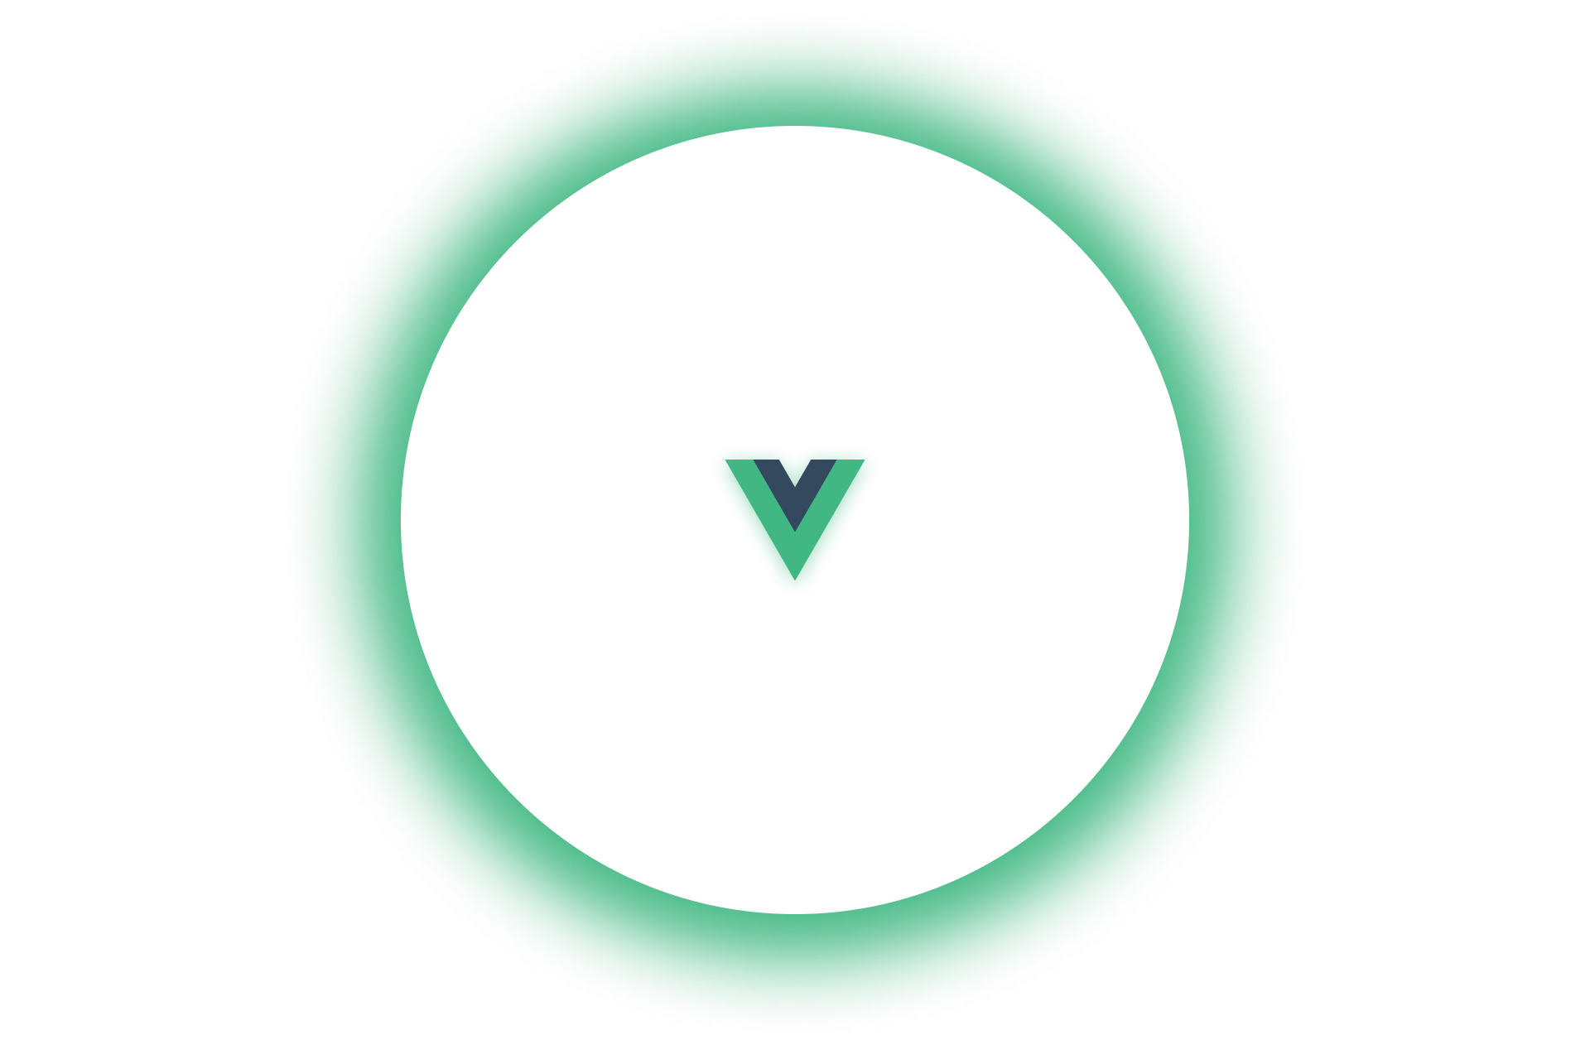
1. Easy to Learn
2. Vue is exceptionally fast
3. Lightweight
4. Virtual DOM Performance and Rendering
5. Two-Way Binding

Slide 9


Slide 10


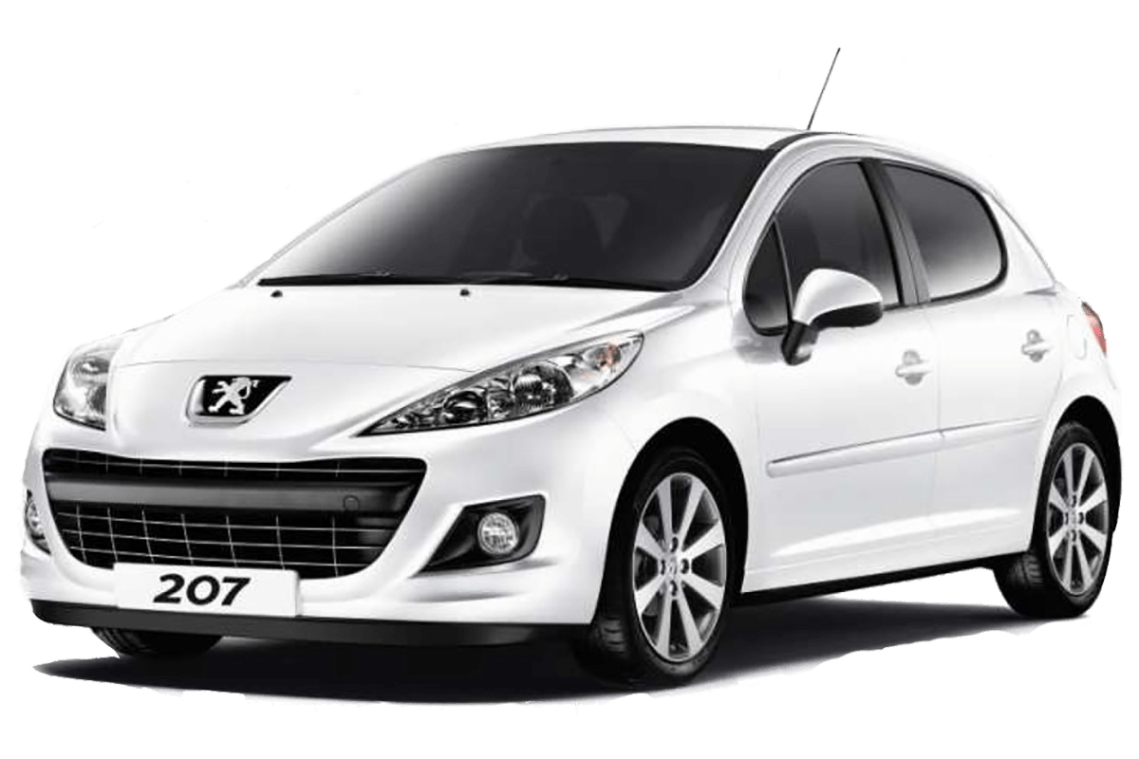
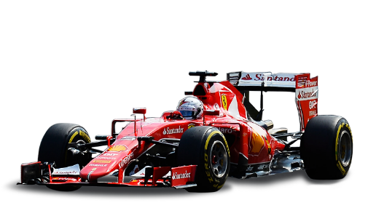

Slide 11

Content
Delivery
Network

Slide 12


Slide 13



Slide 14
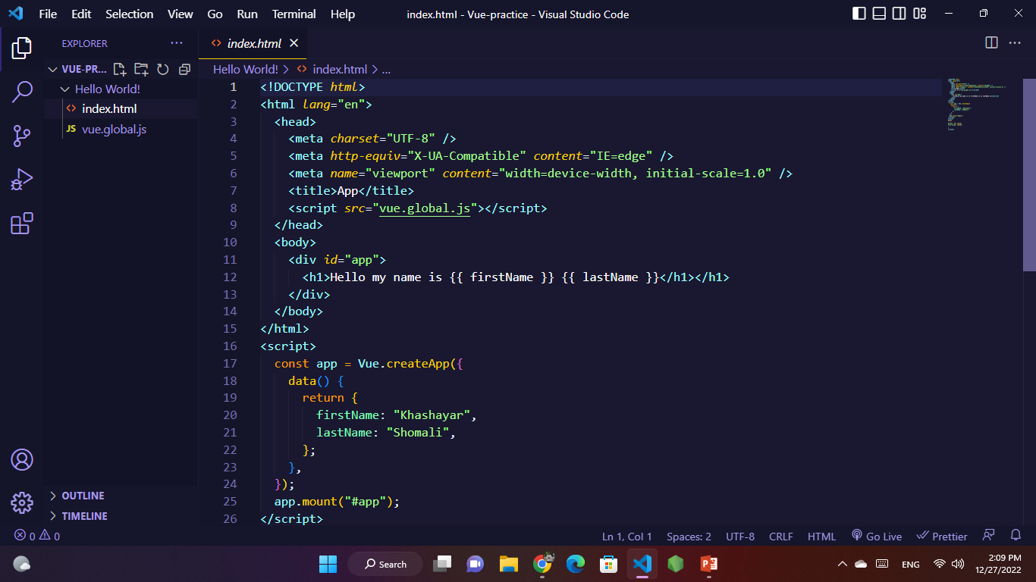

+
Visual Studio Code

Slide 16


Slide 17
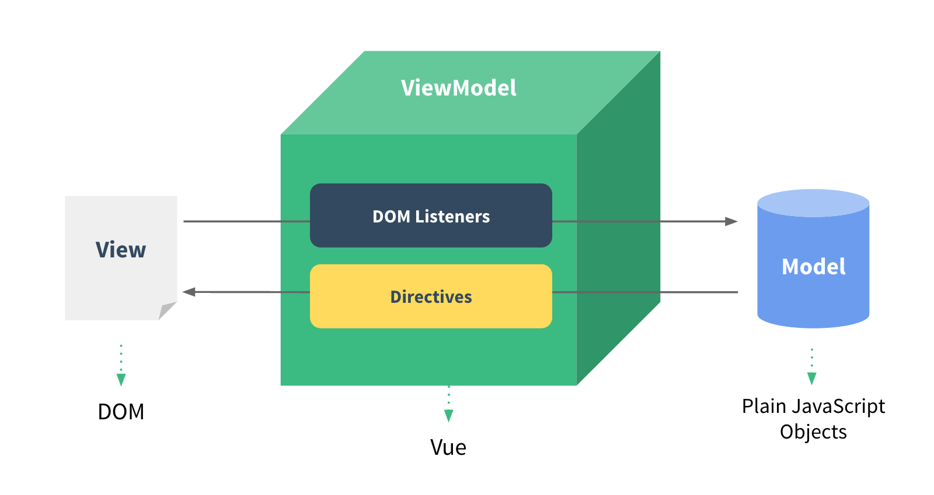

Slide 18
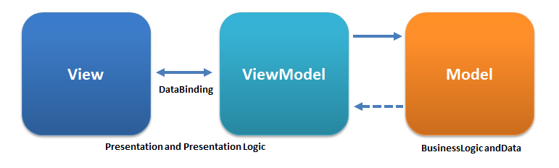

Slide 19


Slide 20
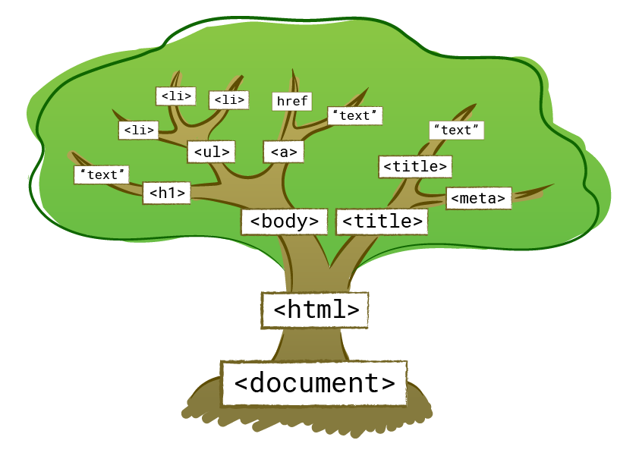

Slide 21
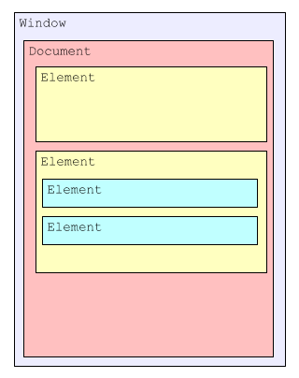
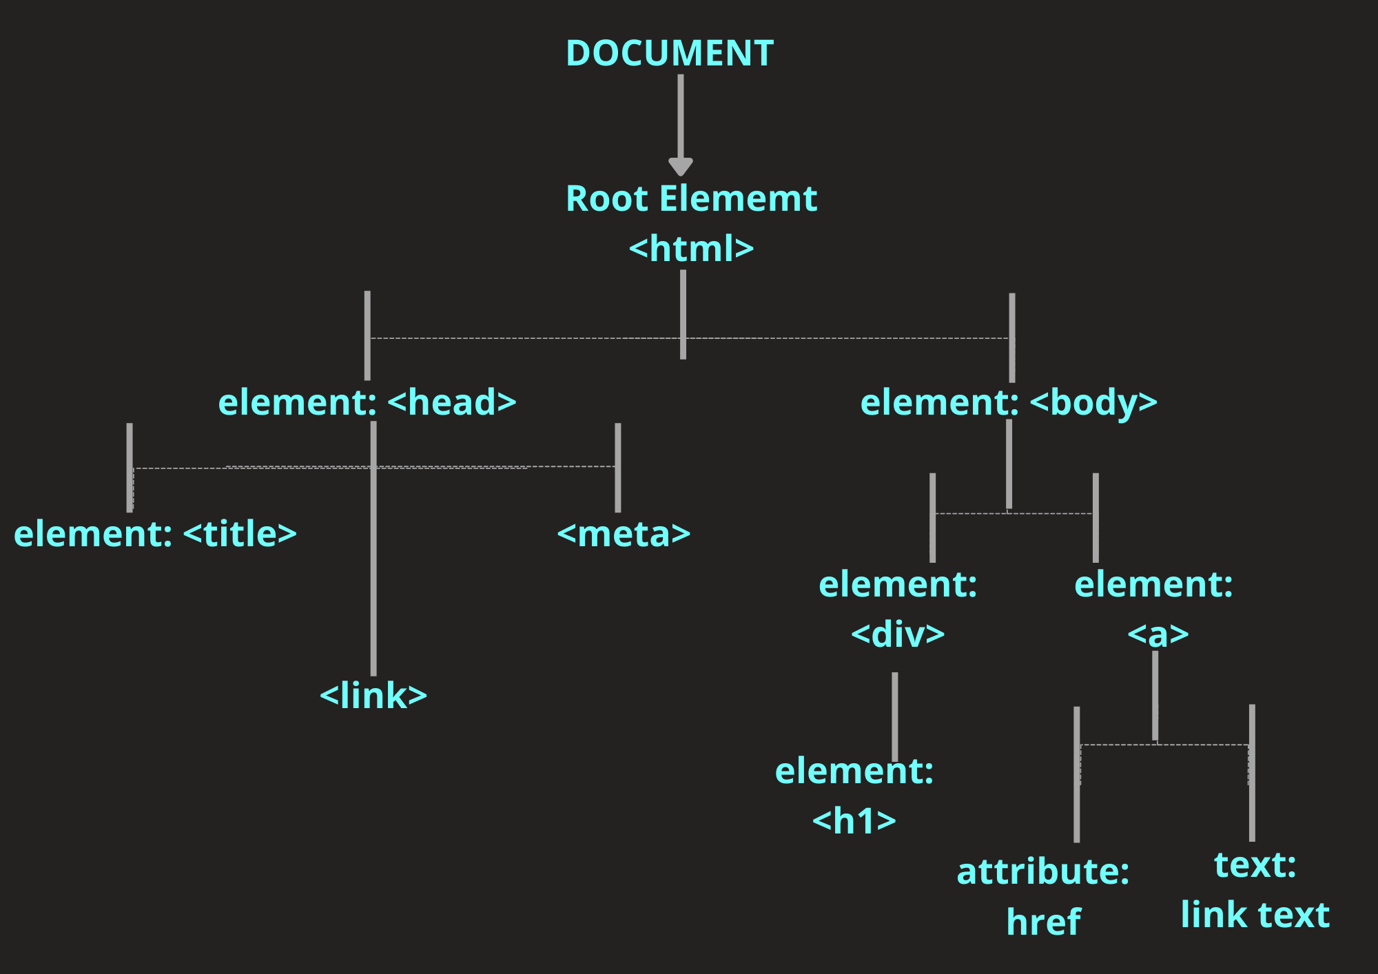

Slide 22
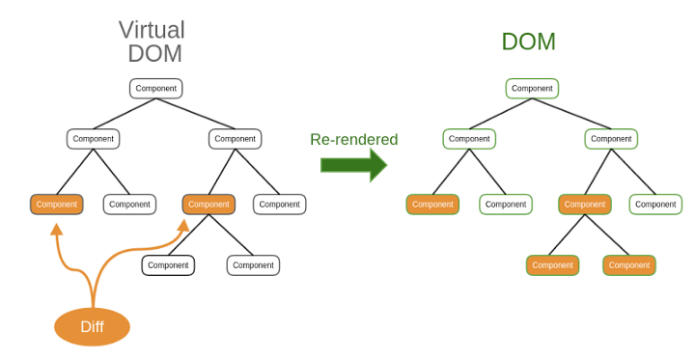

Slide 23


Slide 24
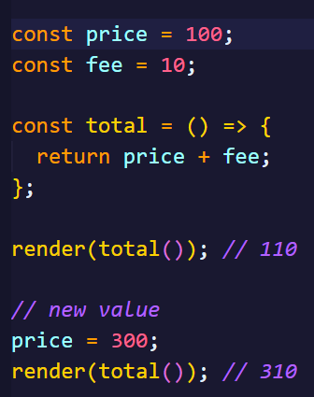
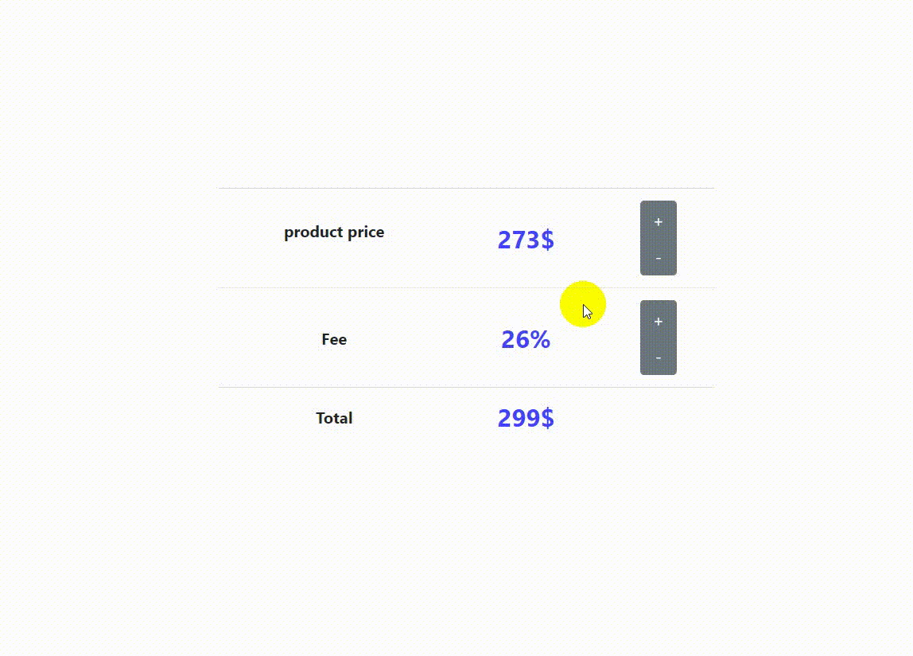

Slide 25
# Creating a Vue Application

Slide 26
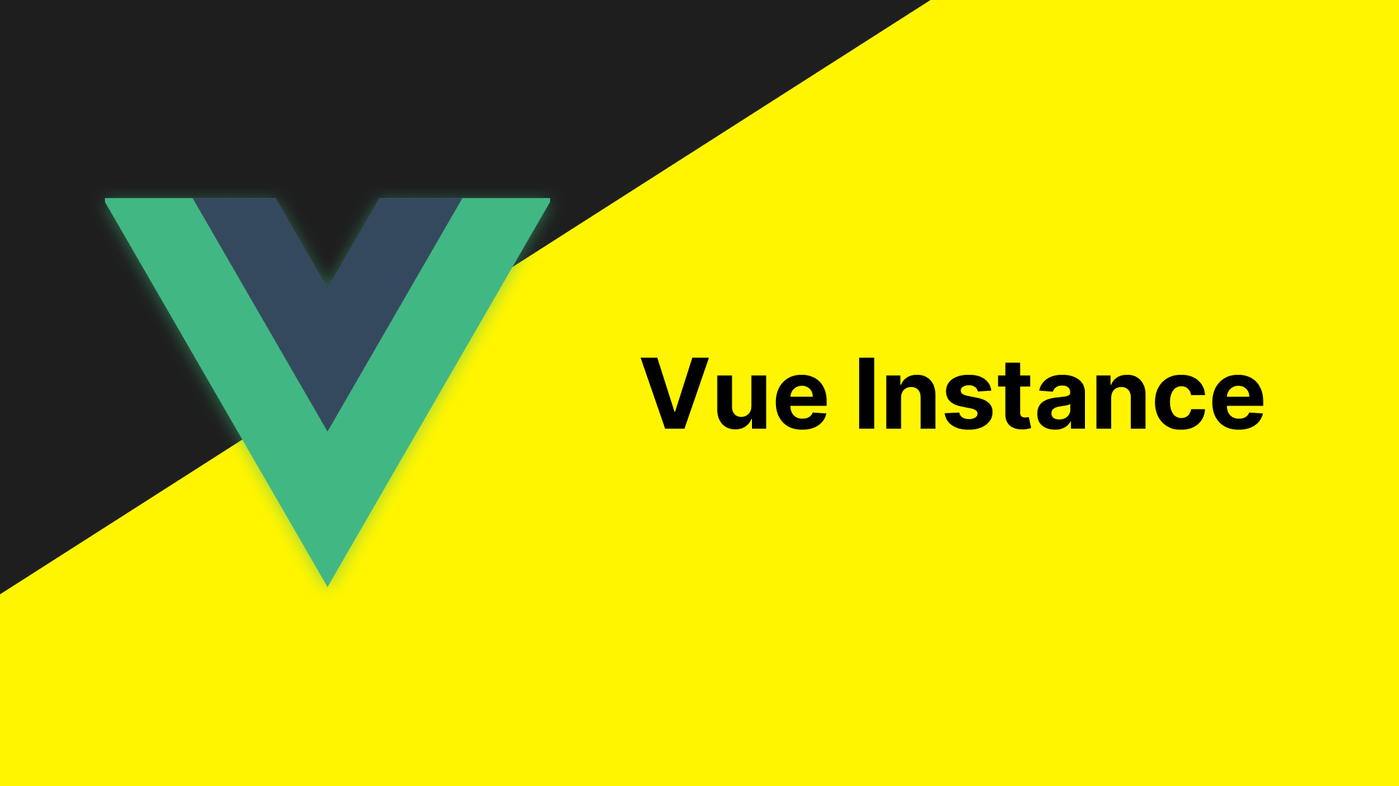

Slide 27
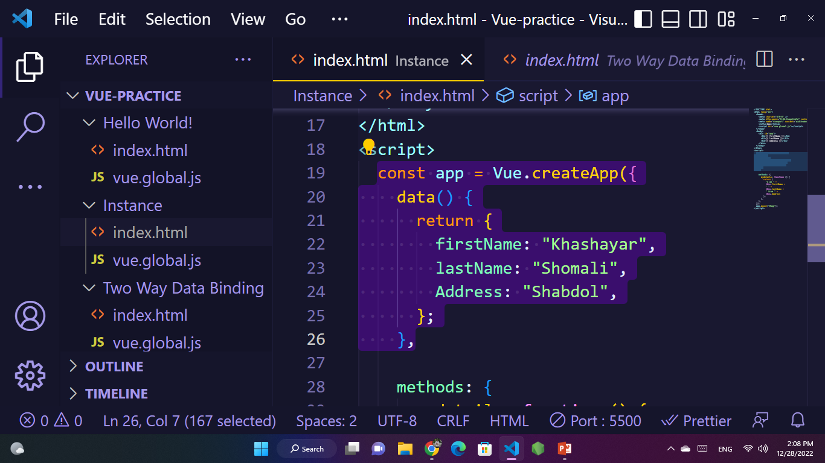
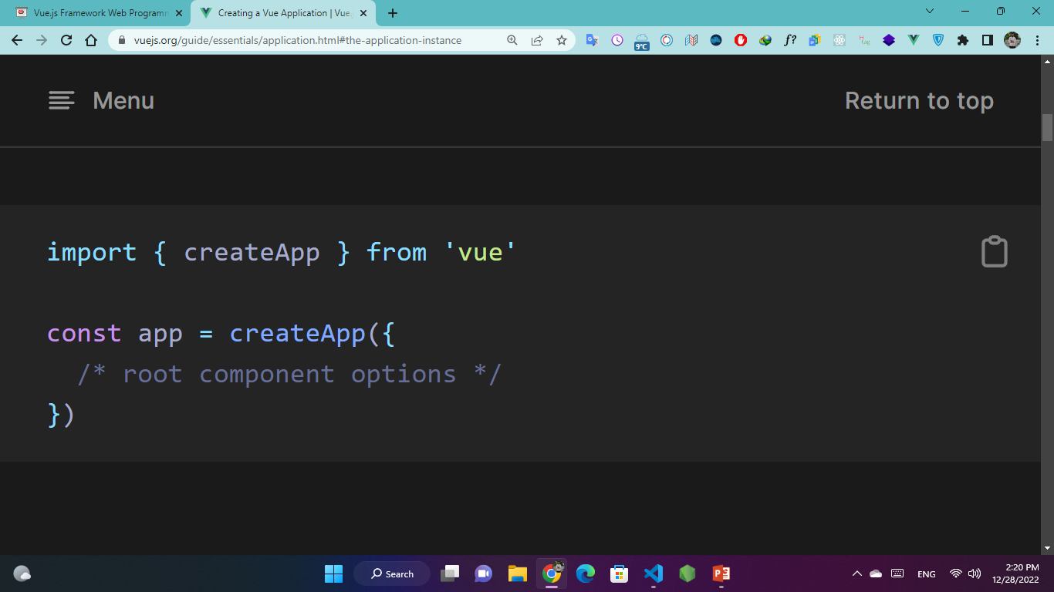
Every Vue application starts by creating a new application instance with the createApp function:
# The application instance

Slide 28


Slide 29
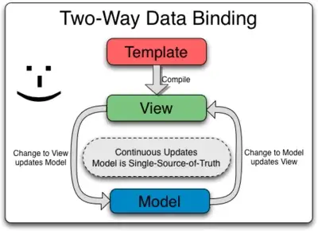
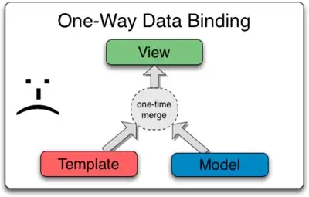

Slide 30

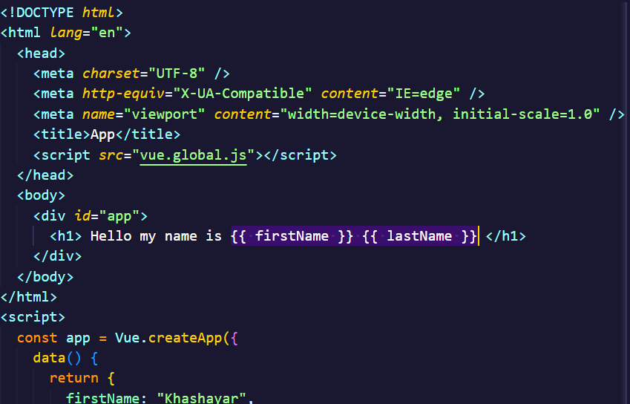
{{ }}
double braces

Slide 31


Slide 32
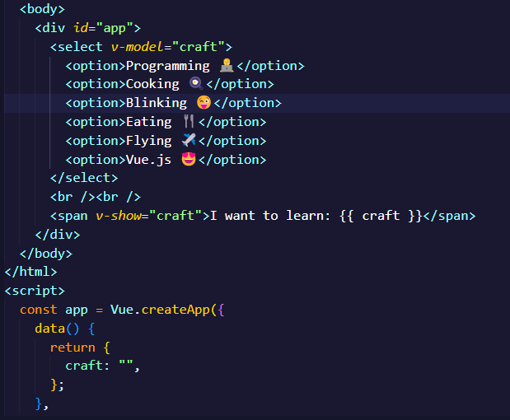
v-if
v-for
v-model
v-bind:class
v-one:click
v-one:change
v-show
v-bind:style

Slide 33


Slide 34
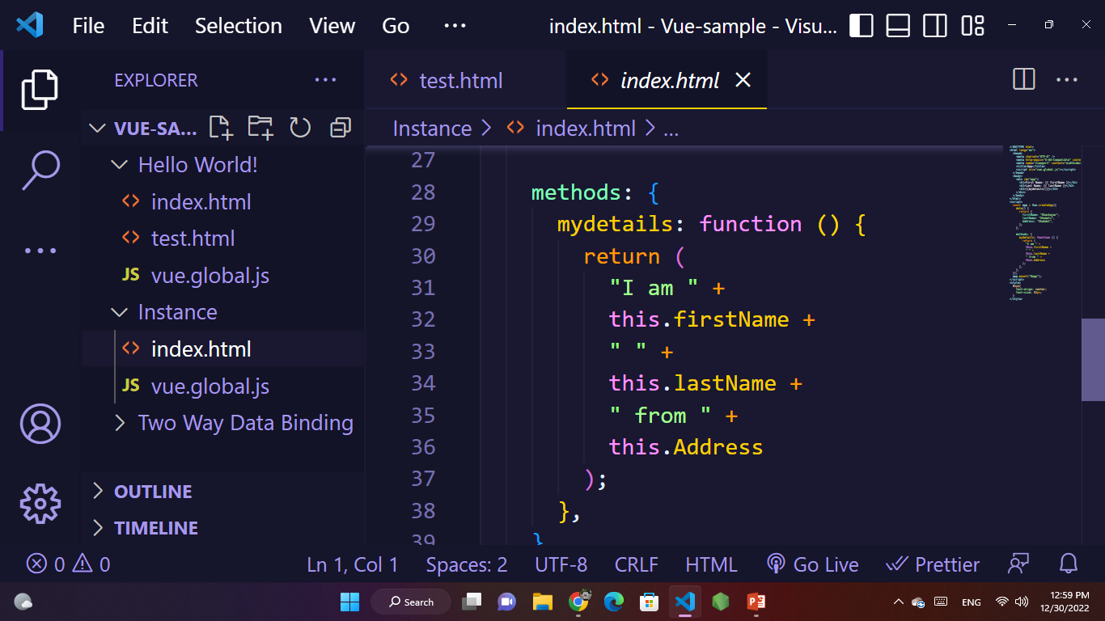
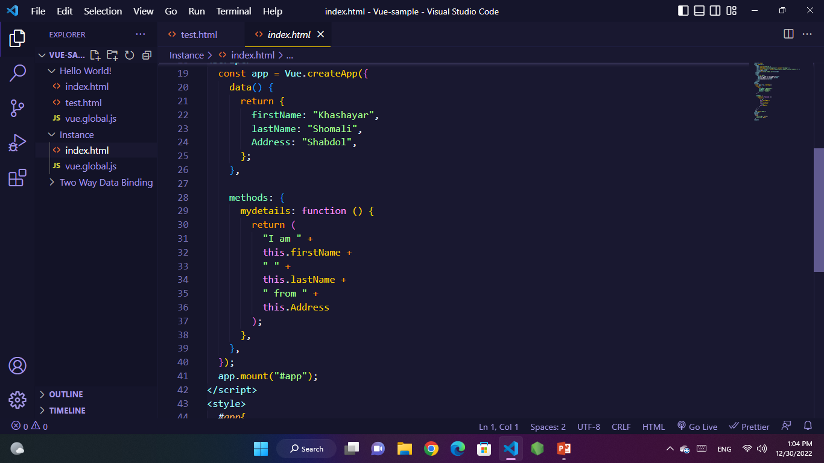

Slide 35
vuejs.org
vuemastery.com
developer.mozilla.org
webprog.io
github.com

